Slide 1
Hiring, Retention, and Pay Equity at Nondescript Services
Ryan Sison

Slide 2
Who I am
Ryan Sison
HR Analyst (1 year at Nondescript Services)
DEI Advocate
Sparkling water enthusiast
Contact Email: rsison@notmail.com

Slide 3
Business Objective & Dataset
Nondescript Services is dedicated to creating and maintaining a diverse workforce in order to benefit from the varied perspectives of our employees.
I have conducted a pay equity analysis and investigated our recruitment/termination data to provide insights to management in order to update our processes in these areas.
The dataset is our employee roster of 311 historic entries; 207 active and 104 terminated.

Slide 4
WHERE We’re Going: Overview
Workforce Diversity Profile
Personal demographics of the workforce
(Sex, Race, and Generation)
Recruitment and Termination Trends
Which demographic groups are recruited from where?
What reasons for termination apply to different demographic groups?
Pay Equity Analysis
When grouped by position, are employees of different personal demographics being compensated similarly when taking into account years of service and performance?
Recommendations
Process recommendations to attract and retain an equitably compensated workforce

Slide 5
Tableau Live Demo
https://public.tableau.com/views/HiringRetentionandPayEquityatNondescriptServices/EmpCountSex1?:language=en-US&publish=yes&:display_count=n&:origin=viz_share_link

Slide 6
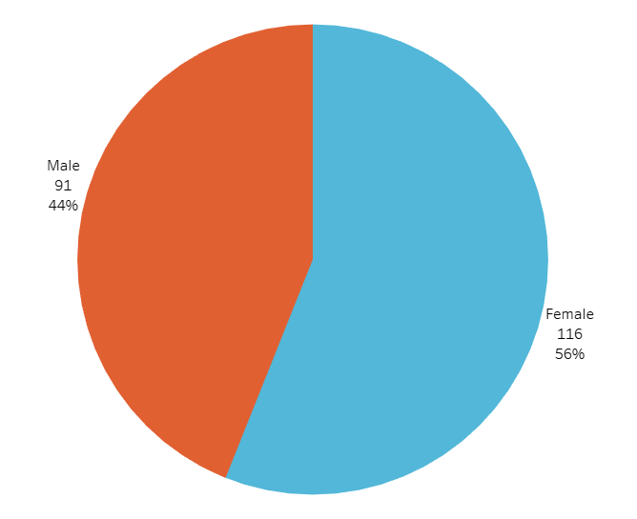
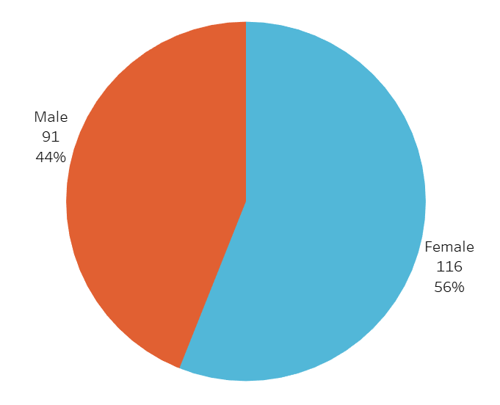
Employee Count by sex
Majority employees are female

Slide 7
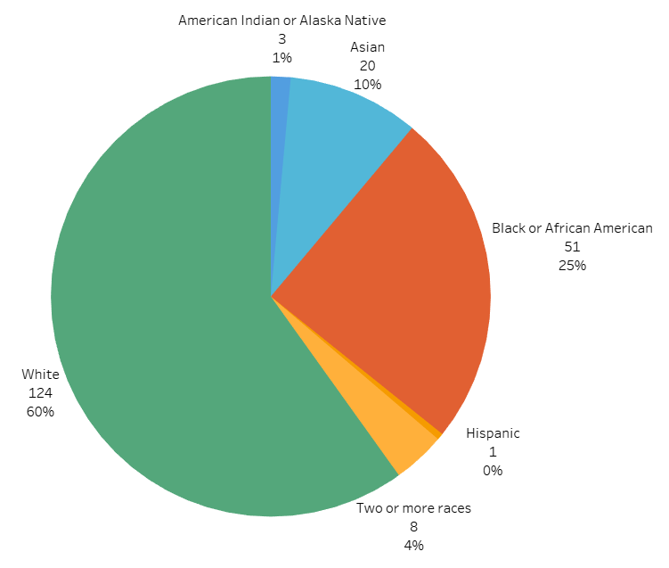
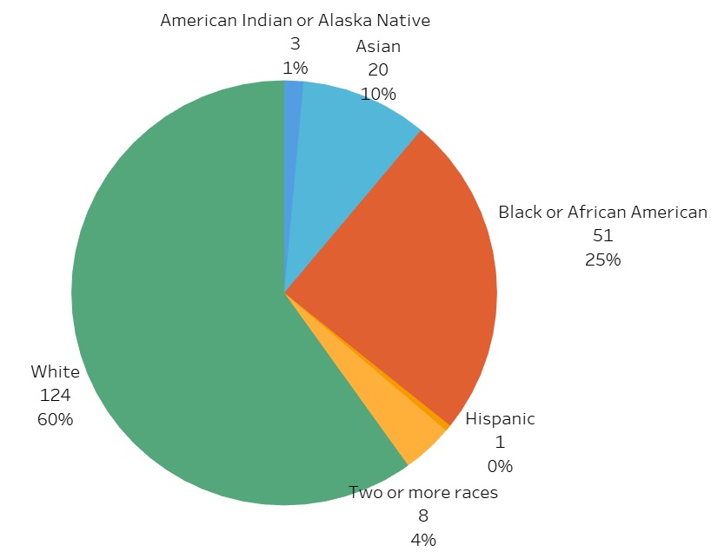
Employee count by race
White employees make up more than half our active roster
Black or African American employees are second most represented
Asian employees are third most represented
We have very few employees who are Two or more races, American Indian or Alaska Native, or Hispanic

Slide 8
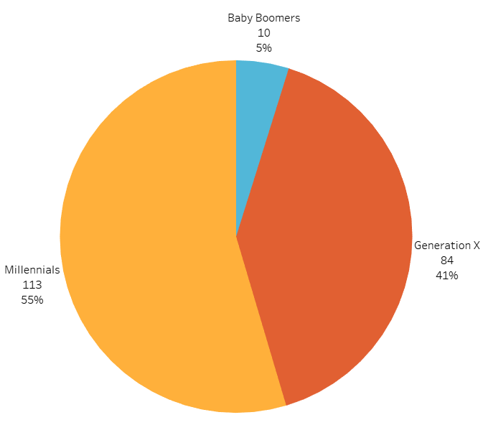
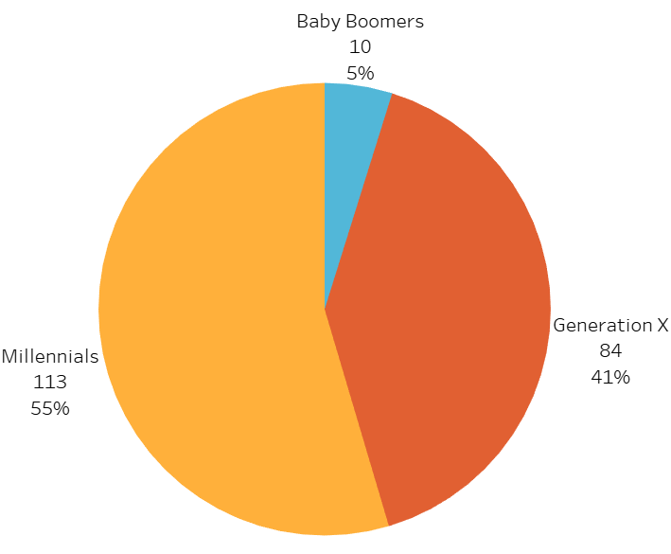
Employee Count by Generation
Millennial employees make up more than half of our active roster
Generation X employees make up close to half of our workforce
Baby Boomer employees are only 5% of our workforce

Slide 9
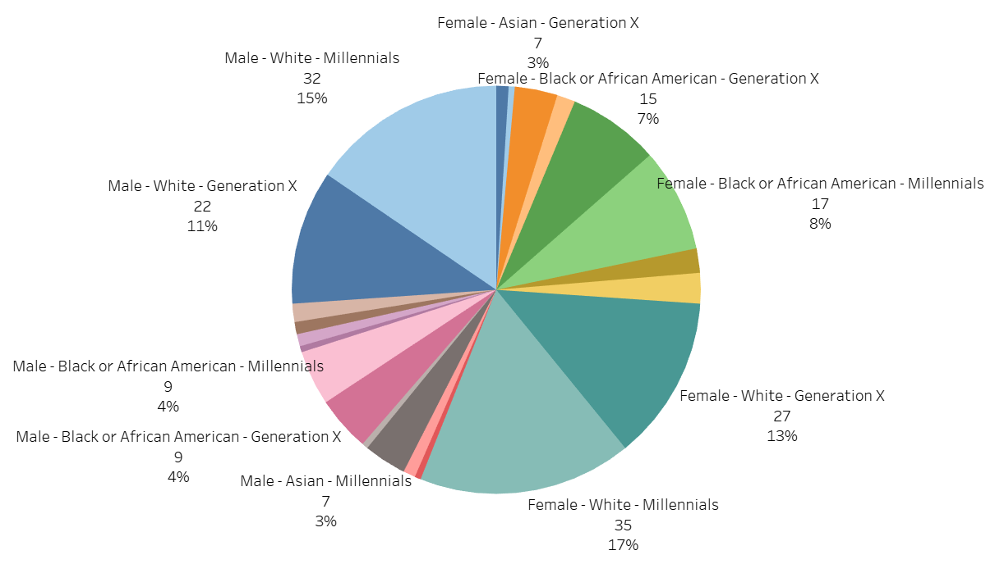
Employee Count By Combo Demographics
1st Male White Millennials 2nd Female White Millennials 3rd Male White Generation X 4th Female White Generation X
5th Female Black or African American Millennials 6th Female Black or African American Generation X
5th & 6th groups combined equate to our largest group
All other combo demographic groups are in single digit percentages with single digit counts of employees

Slide 10
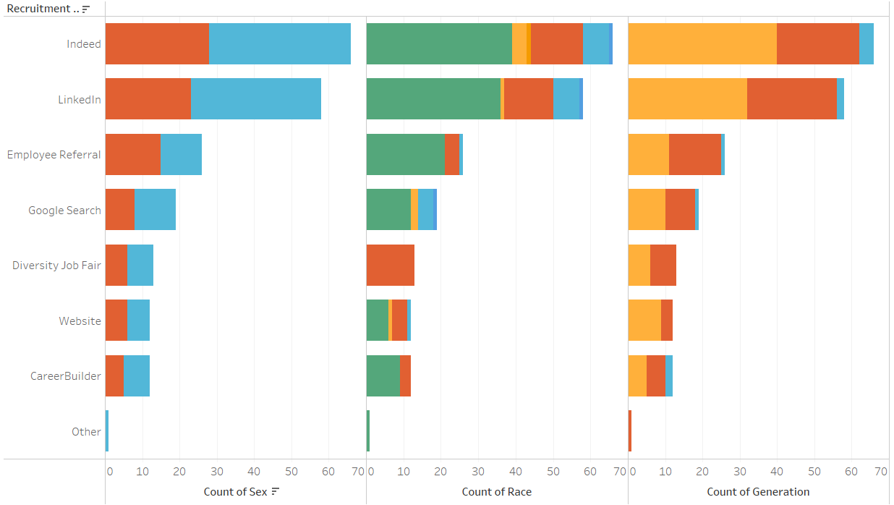

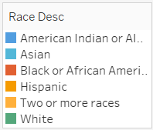
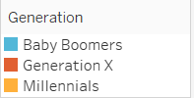
Recruitment Trends
Indeed is our most used recruitment source across all demographics
LinkedIn is similar to Indeed, just less hires from this source
Employee Referral is our third most used recruitment source and has majority male white employees
Diversity Job fair is the outlier in recruitment sources, having only Black or African American hires
Notes:
We are looking at count of recruitment broken down over our three personal demographic categories here
Each column shows the same number of recruitments counts per recruitment source

Slide 11
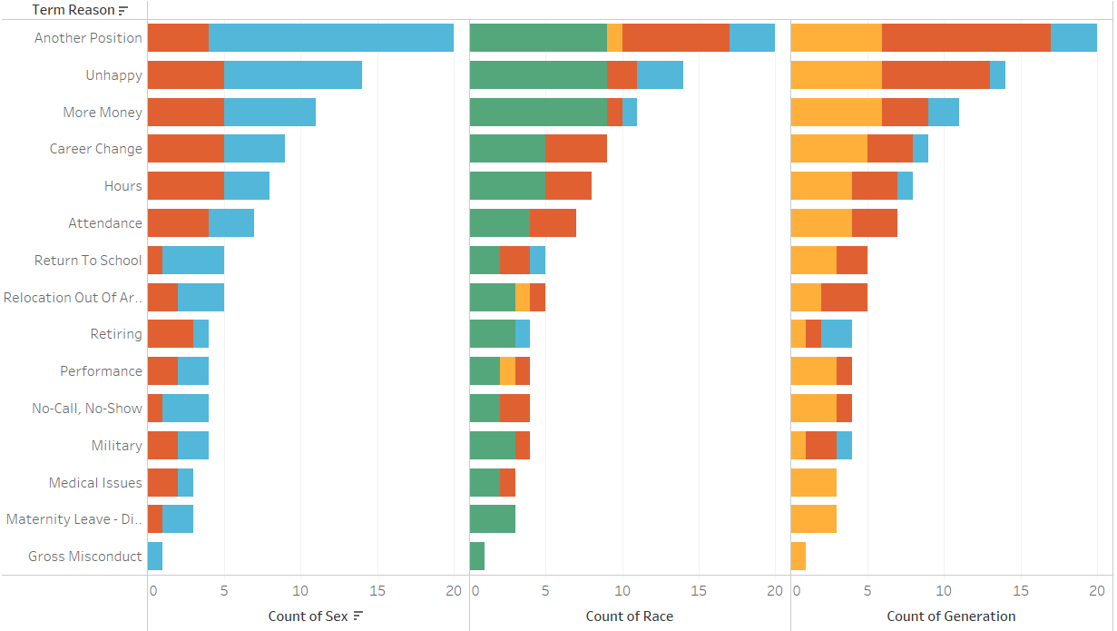
Termination Trends
The termination trends reflect the demographic distribution as a whole
Another Position, Unhappy, and More Money are the top three reasons why employees have been terminated
These three reasons can be intertwined; employees may be unhappy and search for another position because their bottom line is not being met

Slide 12
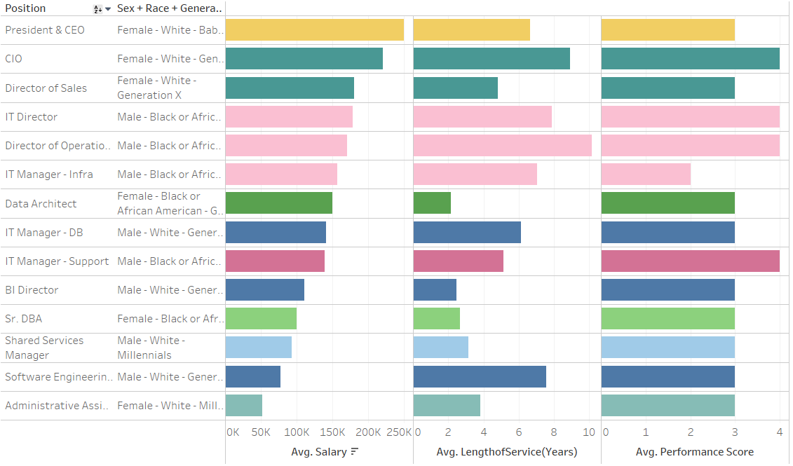
Single Employee Positions Average Salary by Combo Demographic, Length of Service, and Performance Score
Top Earning - President & CEO; a Female White Baby Boomer
10 other single employee positions earning six figures
Length of service and performance score do not tell us a lot here because these are single employees
Data Architect (Female Black or African American Generation X) and BI Director (Male White Generation X) have only two years of service, yet are highly paid
Notes:
-There are some positions which are populated with only one employee
-Because there is no pay comparison to be made with one person per position, we will look at the six figure earning positions in regards to combo demographics to get a sense of who is making the most money at the company

Slide 13
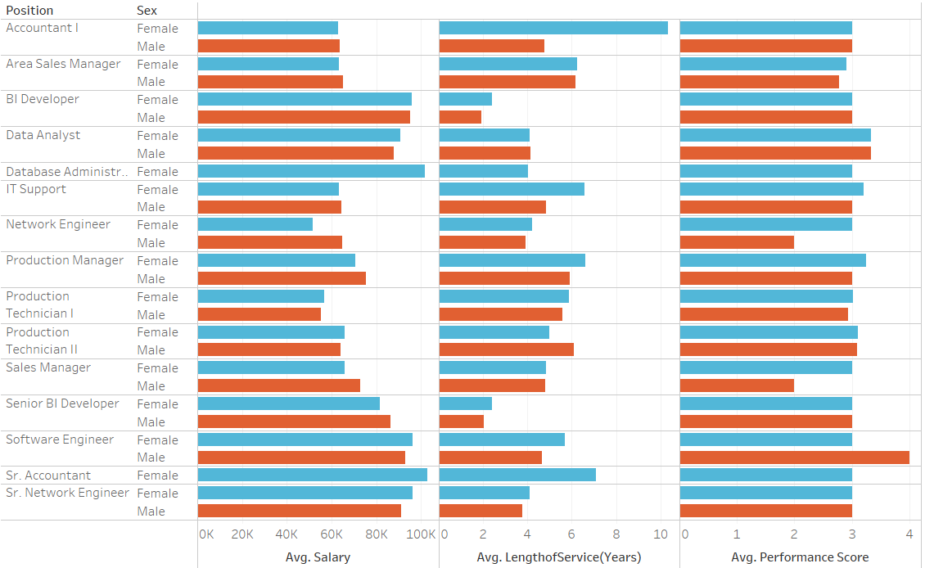
Multi Employee Positions Average Salary by Sex, Length of Service, and Performance Score
We see many positions for which average salary is very close between male and female employees; with length of service and performance also being similar

Slide 14
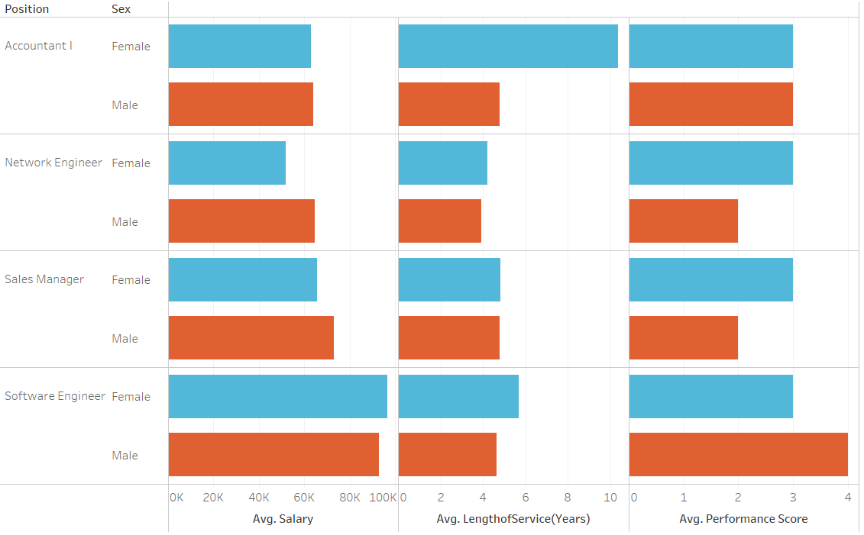
Multi Employee Positions Average Salary by Sex, Length of Service, and Performance Score
Network Engineers who are male make around 13,000 more than female engineers. That is 25% of the average female network engineer salary. Male and female engineers have the same service length and female engineers have a higher performance score
Sales Managers who are male make about 7,300 more than females, yet they have the same length of service and females have a higher performance score. That difference is 11% of the average female Sales Manager salary
One female accountant has 10 years of service but is paid about the same as the other two male accountants who have half as many service years
One male Software Engineer is making slightly less than his female peers, but has a 4 “Exceeds” expectations performance score

Slide 15
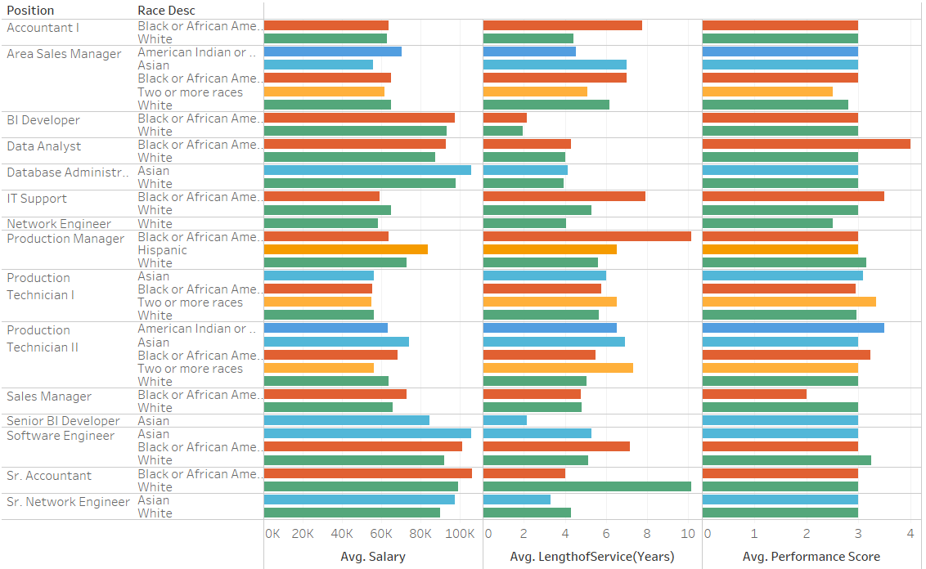
Multi Employee Positions Average Salary by race, Length of Service, and Performance Score
Many positions salary is comparable across races and length of service and performance are similar
We will focus on positions where the difference is 10% or more of a groups current average salary… with white employees being our base group for comparison
Note that white employees are not always the highest paid race within a position, but they are used for our initial pay comparison across groups

Slide 16
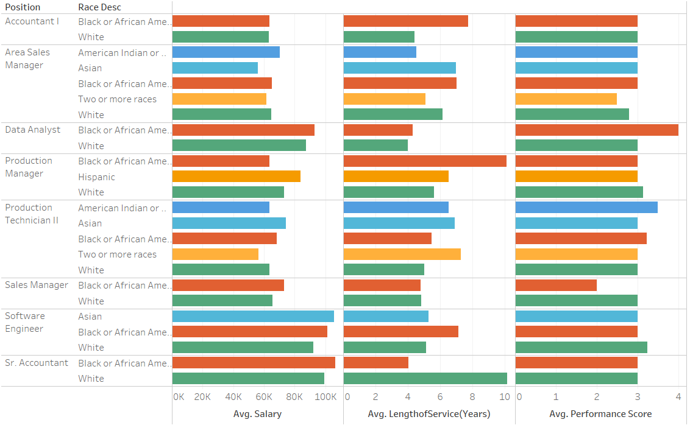
Multi Employee Positions Average Salary by race, Length of Service, and Performance Score
Area Sales Managers who are White make about 8,981 more than Asians. That difference is 16% of the current average salary for an Asian Area Sales Manager. American Indian or Alaska Native Area Sales Managers make the most; about 5,700 more than their white counterparts.
Production Managers who are White make about 9,400 more than Black or African American. That is 15% of the average salary for a Black or African American Production Manager.
A Hispanic Production Manager is making about 11,000 more than their White counterparts.
The Product Technician IIs who are White make about 7,300 more than the employee of Two or more races. That is 13% of that employee’s salary. An Asian Product Technician II is making about 11,000 more than their White counterparts.
The Sales Manager who is Black is making about 7,300 more than their White counterpart. The difference accounts for 11% of the White employee’s current salary.
For the Software Engineer position, the Asian employee is making about 14,000 more than the average salary of their White counterparts. The difference accounts for 15% of the White employee’s current salary.

Slide 17
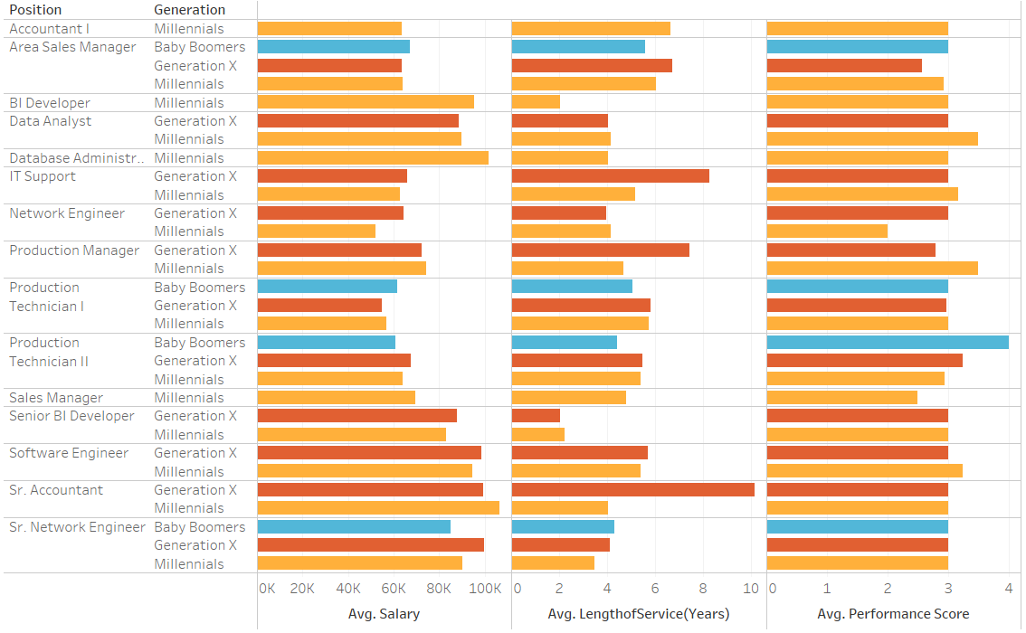
Multi Employee Positions Average Salary by generation, Length of Service, and Performance Score
Baby Boomers will be the base group for comparison except in instances where there are none; Generation X is used
Note that Baby Boomers are not always the highest paid generation within a position, but they are used for our initial pay comparison across groups

Slide 18
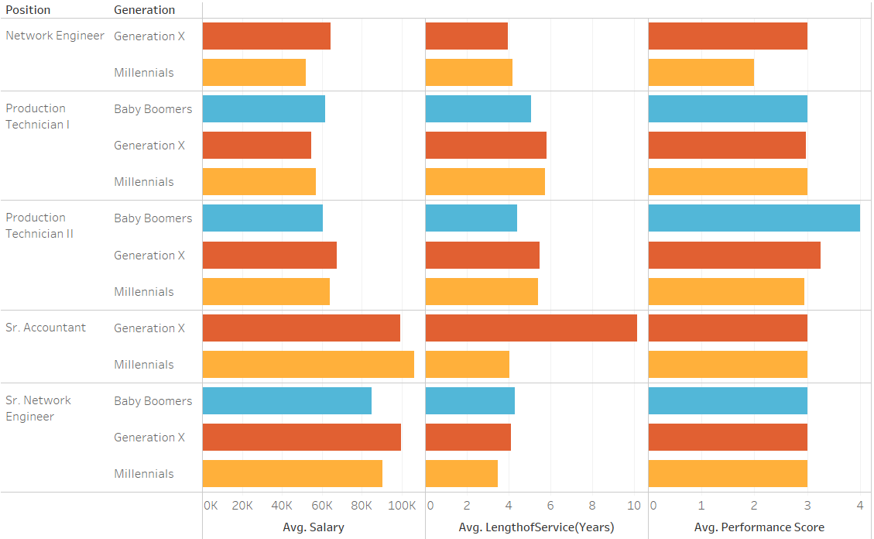
Multi Employee Positions Average Salary by generation, Length of Service, and Performance Score
Network Engineers who are Gen X make about 12,000 more than Millennials. That difference is 24% of the average salary for the Millennial employees.
Product Technician I who are Baby Boomers make about 6,900 more than Gen X. That difference is 13% of the current average salary for the Gen X employees.
Product Technician II who are Gen X make about 6,800 more than Baby Boomers. That difference is 11% of the current average salary for the Baby Boomer employees.
Sr. Network Engineer who are Gen X make about 14,700 more than Baby Boomers. That difference is 17% of the current average salary for the Baby Boomer employees.

Slide 19
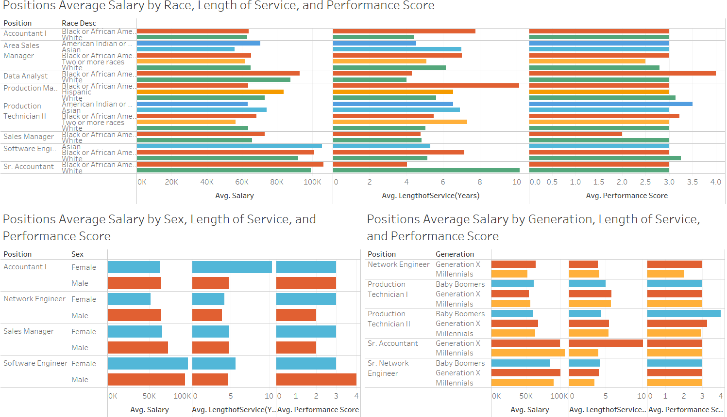
Pay inequities Dashboard
Notes:
On this dashboard I have consolidated the positions for which inequities have been identified across personal demographics

Slide 20
Recommendations
Raise wages for employees in identified positions with inequity. Individual employee salaries will need to be analyzed for adjustment as we have used averages here to identify initial inequity.
Recruit more from diversity job fairs and less from employee referrals. Identify additional sources like “diversity job fair” to recruit groups for which we have very few employees.
Implement a pay structure that includes years of service and merit-based increase (performance score).

Slide 21
THANK YOU

